Slide 1
Inflow and outflow forecasts of Yuebao Monetary Fund
Lai Lin 1801212867
Lian Di 1801212881
Liu Sheng 1801212891
Alimujiang 1801212778
He SongTao 1801212852
2020-01-13

Slide 2

CONTENTS
01 Introduction to Yu’e Bao
02 Feature Engineering & Selection
03 Model Analysis
04 Training, Evaluation & Prediction
05 Result Analysis & Interpretation

Slide 3
01
Introduction to Yu’e Bao

Slide 4
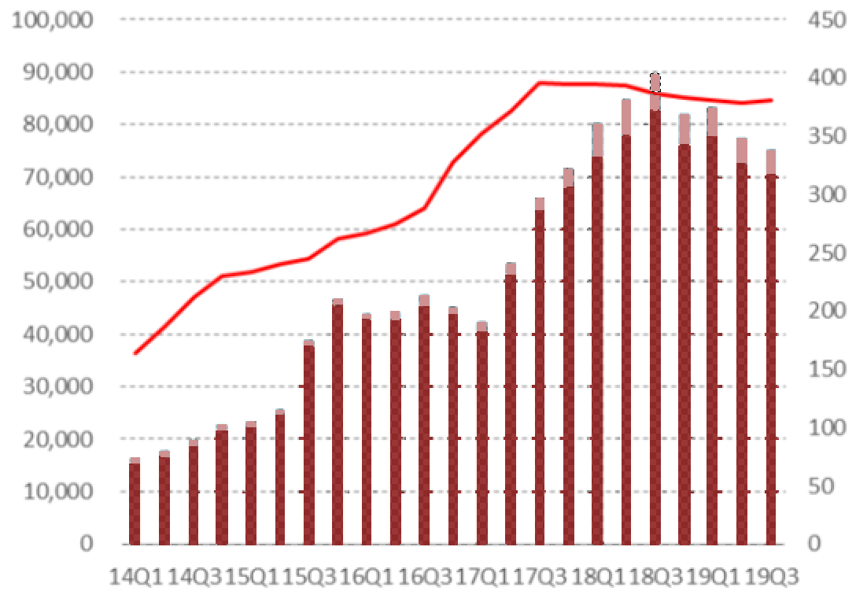
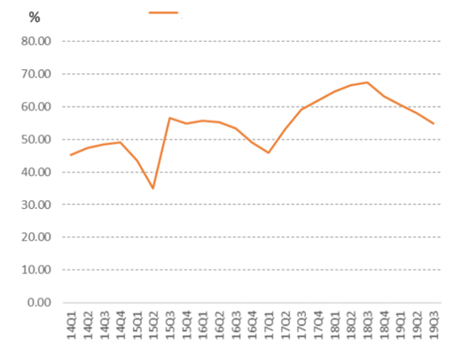
1.1 What is Yu’e Bao?
Yu’e Bao, launched by AntFin in 2013, a monetary market fund invested in short-term securities
Underlying: Government bonds, central bank bills, high rating corporate bonds
Avg. maturity: 120 days
Advantage: High security, high liquidity, stable returns -> "quasi-deposit“
Yu’e Bao is now a MMF platform
Only docked with Tianhong Yu’e Bao (world ’s largest MMF) in 2013
Docked with more than 20 MMFs now
User of Tianhong Yu’e Bao: 619.19M as of 2019H，half of China's population
MMFs seem less popular than before, why?
MMFs fund scale continues to shrink
Percentage of MMFs continues to shrink
(x100M￥)
(#)
MMFs Scale
Wealth Mgmt. Product Scale
Total Amount
MMFs / Public Funds

Slide 5
1.2 Why the scale of Yu’e Bao has fallen?
In Sep. 2017, the CSRC issued regulations on MMFs
"All MMFs investing in bank deposits, interbank certificates of deposit and bonds must not exceed 10% of commercial bank’s net asset at the end of quarter.“
However in 2016,
Bank’s net assets were 9.8 trillion → MMFs investment cap was only 0.98 trillion
Yu’e Bao fund scale had exceeded 1.5 trillion
Yu’e Bao’s policy on fund scale for each user
Tianhong Yu’e Bao’s scale
1,000 k
250 k
100 k
Jun. 2013 May 2017 Aug. 2017
Cap in 2016
20 k
Dynamic Quota
Quota Cancelled
Dec. 2017 Feb.–Mar. 2018 April 2019

Slide 6
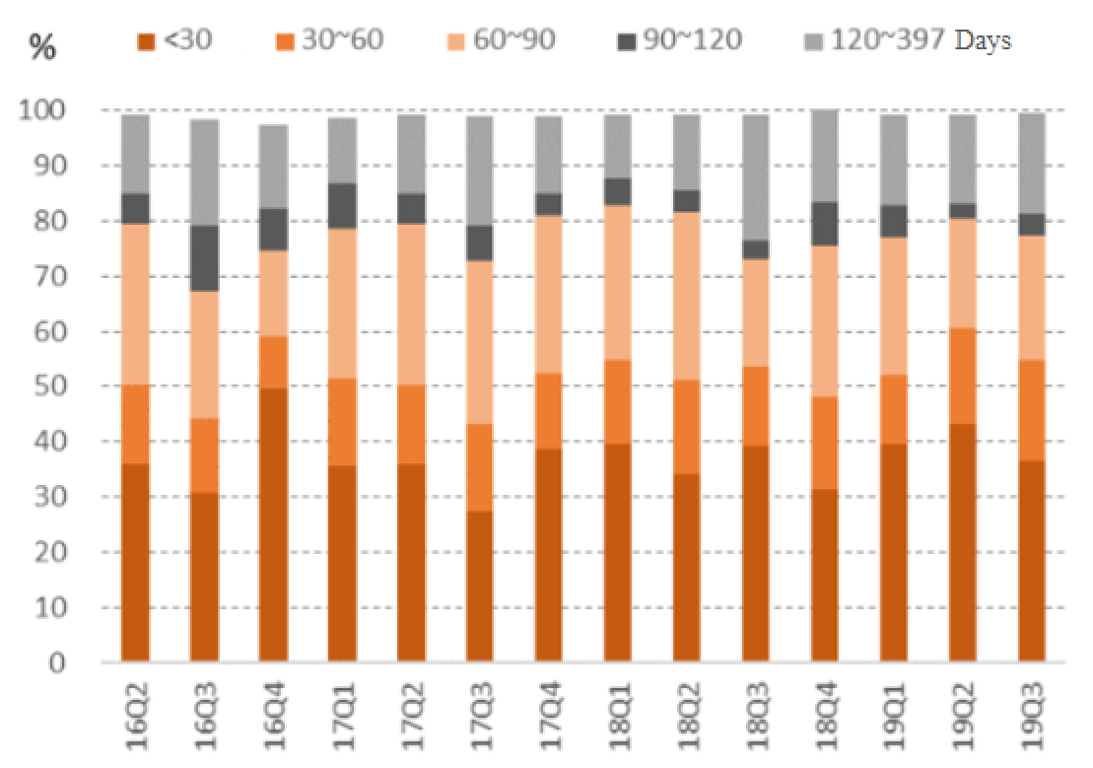
1.3 Significance of inflow and outflow of Yu’e Bao
1. Accrue appropriate risk reserves
Net Worth:
1.5 T
Why MMFs need reserves?
Market yields rise → Bond prices fall
Redemptions of MMFs → Sell bonds before maturity → Net worth decrease → Redemptions → …
CSRC’s regulations on MMFs also stipulates:
Total net worth at month-end must not exceed 200 times the monthly balance of the risk reserve
Reserve:
7.5 B
MMFs’ trend:
short-term asset -> long-term asset
2. Time-matched asset allocation
Allocates assets of appropriate duration according to the inflow and outflow to reduce liquidity risk

Slide 7
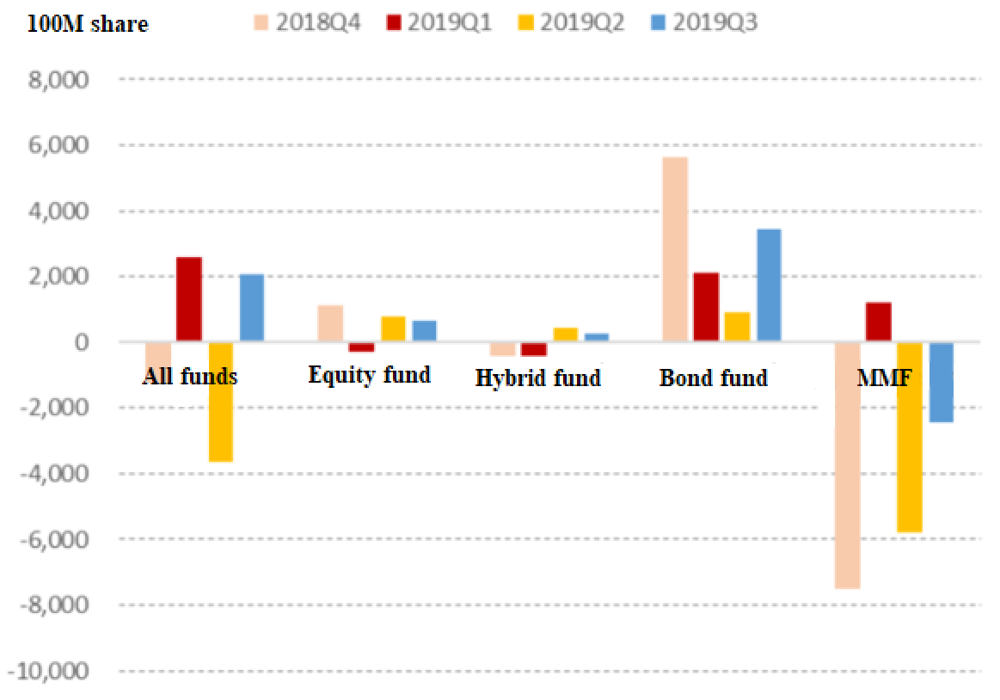
1.4 The problem we want to solve
Prediction model: Forecast the future fund inflows and outflows of Yu’e Bao
Application: For fund managers’ reference to manage positions and make risk reserve
Data selection: Purchase / redemption amount in 2014, since CSRC’s regulation in 2017 is an important exogenous variable
Features might affect Yu’e Bao funds inflow and outflow.
Macro features: SHIBOR, stock market expected returns (investor opportunity cost)
Micro features: user liquidity preference (holiday, weekend…), time-series correlation
Tianhong Yu’e Bao’s rate of return
Change in scale of different funds
CSRC’s Regulation
2-year time deposit rate

Slide 8
02
Feature Engineering
& Selection

Slide 9
2.1
Feature Engineering

Slide 10

Individual investors
Possessor Structure
in 2014
Individual investors
Idle funds
Draw money whenever they need
Holiday Effect
Source: the annual report in 2014

Slide 11
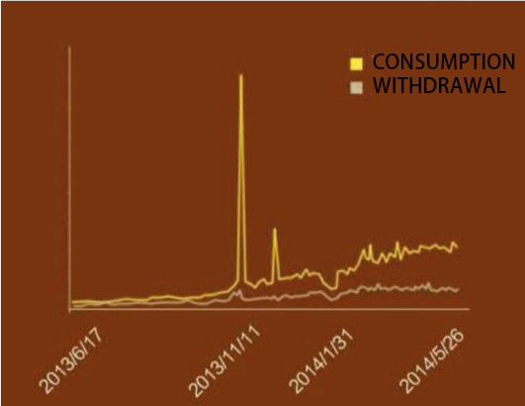
Holiday features
Further decomposed into:
Consumption
Withdrawal
Average daily consumption of Yu ‘ebao = 3*the withdrawal times
Highlighting the e-commerce nature of Yu 'ebao
Holiday features must be constructed
11

Slide 12
× GC001 & √ Shibor
 | Projects | Amount（RMB:Yuan） | Percentage(%)
1 | Fixed income investment | 46,190,560,822.30 | 7.97
 | Bonds | 45,369,753,378.68 | 7.83
 | ABS | 820,807,443.62 | 0.14
2 | Buy resale financial assets | 41,156,051,875.07 | 7.11
 | Redemptory Monetary Capital for Sale | 124,918,607.40 | 0.02
3 | Bank deposits and settlement reserves in total | 490,582,488,639.75 | 84.69
4 | Other assets | 1,310,519,405.69 | 0.23
5 | In total | 579,239,620,742.81 | 100.00
Inter-bank market: People‘s Bank of China, Commercial Banks, Securities Firms, Monetary Funds, Bond Products，Insurance, Financing companies
Exchange market: retail investors, Equity products
× GC001
√ Shibor
Portfolio
Source: the annual report in 2014

Slide 13

Balance of Margin Trading & Securities Lending
Monetary Fund ← Fluctuation of financial market capital
After the reform of new shares issued in June 2014
A strong influence on the monetary fund both in the short term & the long term
√ Balance of Margin Trading & Securities Lending
Notes:
融资融券，是股票交易中的一个专用术语，是指通过向券商借钱买入股票、借股票卖出（卖空）股票的交易方式。在英文中，融资可以翻译为：trade on margin，或者margin trading。而融券，则可以说：selling short，或short selling。而提供这种融资融券操作的证券账户叫做margin account，中文里往往叫做：信用账户、保证金账户、融资融券账户等。

Slide 14
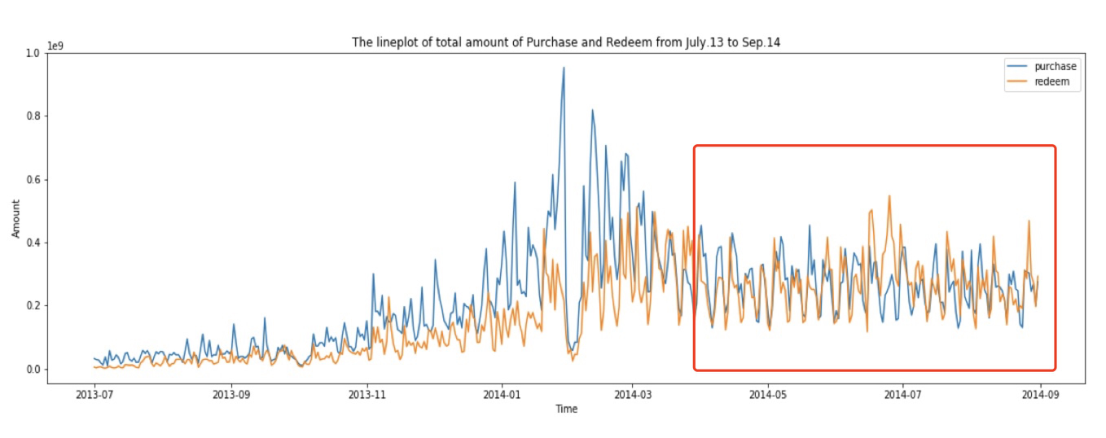
Time series analysis
Obvious periodicity on a seven-day basis
Trend:
July 2013 to Nov. 2013: relatively low
Nov. 2013 to Apr. 2014: relatively large fluctuations
Apr. 2014 to Aug.2014.: a stable period

Slide 15
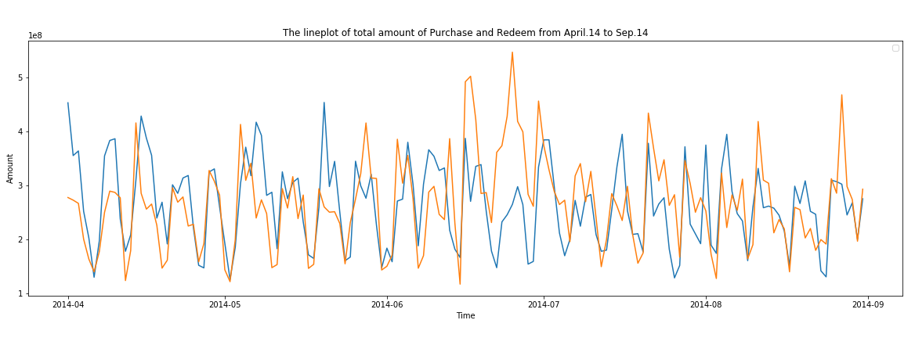
Time series analysis
Regular user behavior ← data to be relatively smooth
Select samples to describe the characteristics of September
choose the data of the stationary period from April to August for modeling （DF Test）
Notes:
Eg. the 3-day Mid-Autumn festival in September requires similar holiday characteristics in the sample to describe this feature.

Slide 16
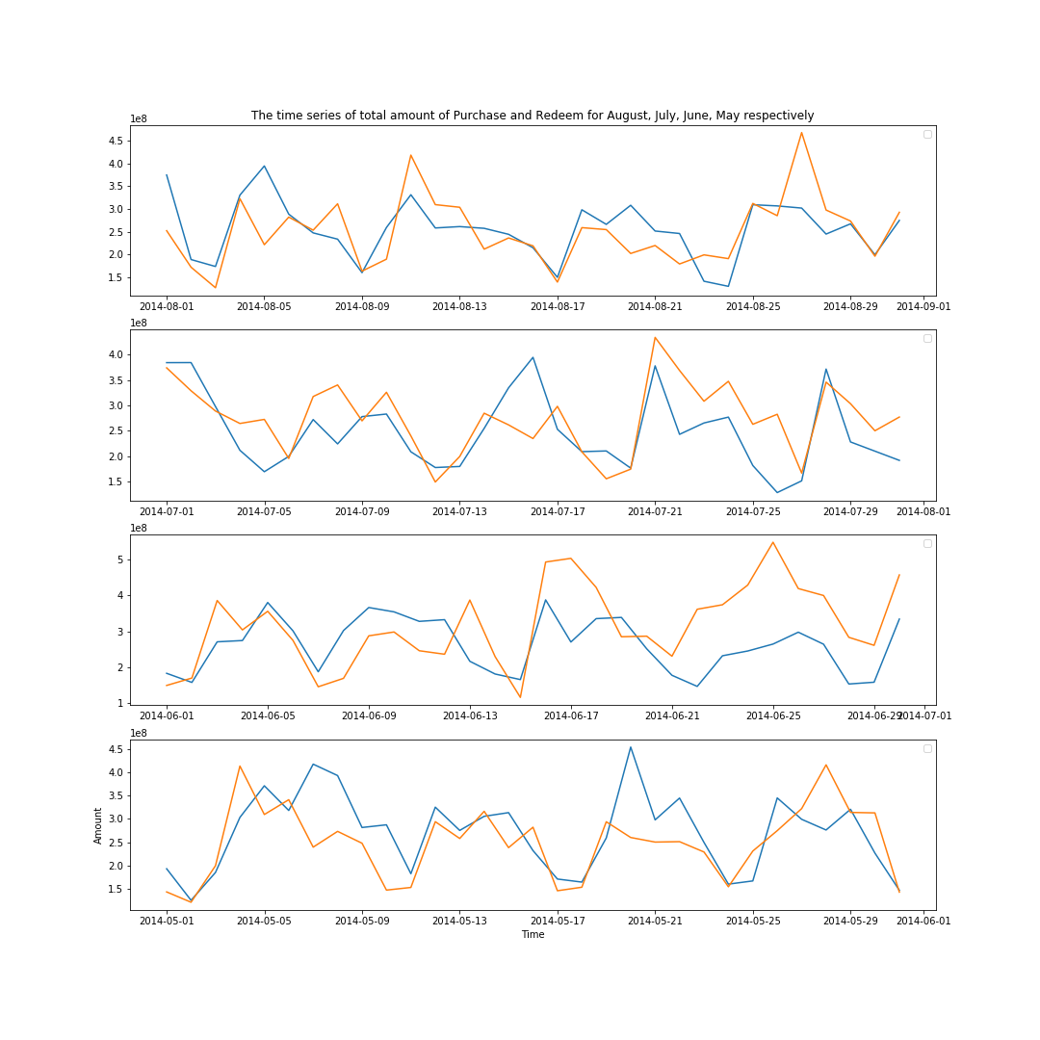
Time series analysis
Time series diagram of each month
it has a feature of a seven-day cycle
→ Confirm our previous thoughts

Slide 17
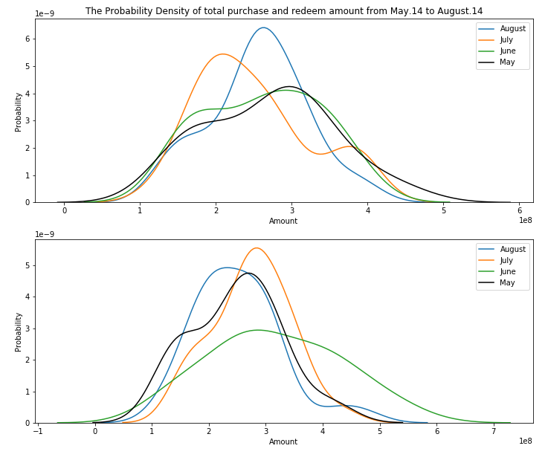
Time series analysis
Plot the probability density of total purchase & redeem amount from May.14 to August.14
Add monthly features for analysis

Slide 18
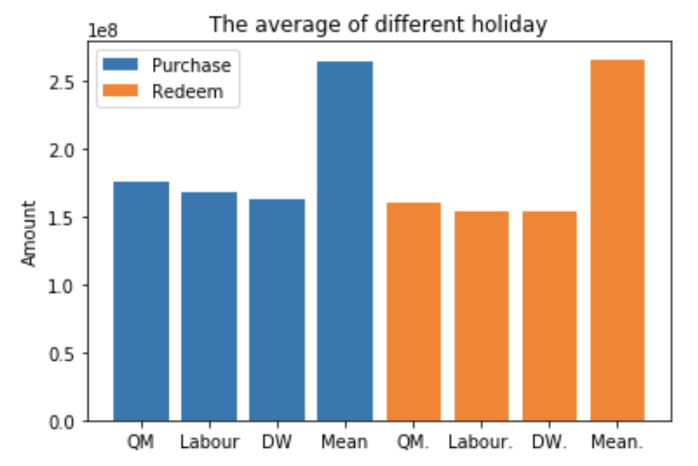
Holiday Features
Comparing the number of purchase & redemption between holidays and mean
For time series
“is” feature based on date static feature
“distance” feature
The average of different holiday

Slide 19
2.2
Feature Selection

Slide 20
Feature selection Process
Low separation ability
Multi-collinearity
Feature engineering:
Generate additional features
Eliminate irrelevant, redundant, or highly correlated features
Feature selection:
Select a subset of relevant, useful features to use in building an analytical model
Low correlation
Shapley value
Permutation
Importance

Slide 21
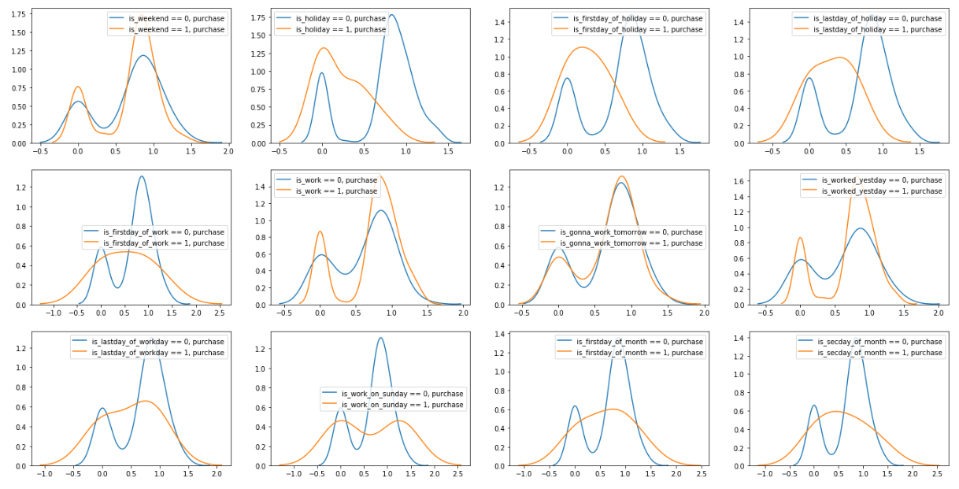
1. Delete features with low separation ability

Slide 22
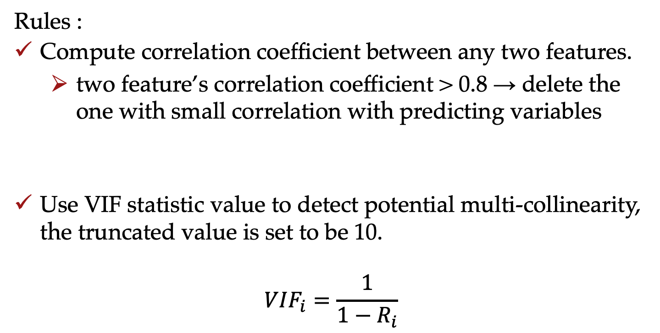
2. Delete features with Multi-collinearity
Rules :
Compute correlation coefficient between any two features.
two feature’s correlation coefficient > 0.8 → delete the one with small correlation with predicting variables
Use VIF statistic value to detect potential multi-collinearity, the truncated value is set to be 10.
$$VIF_{i}=\frac{1}{1−R_{i}}$$

Slide 23
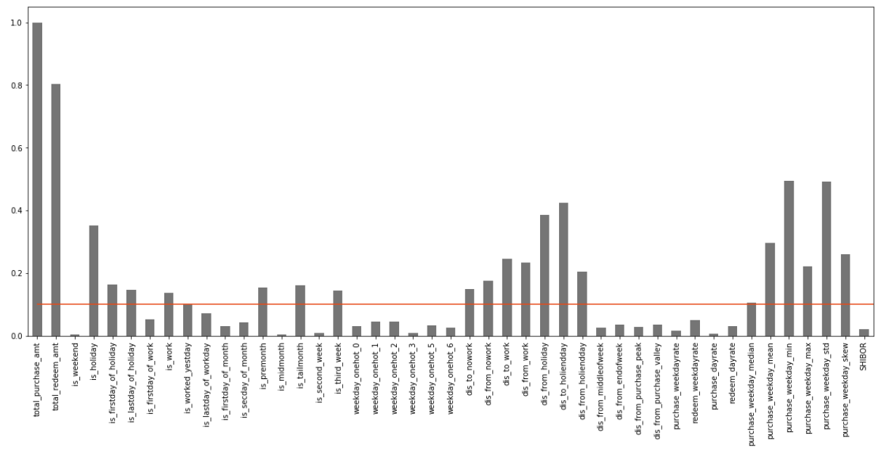
3. Delete features with low correlation
Threshold：0.1

Slide 24
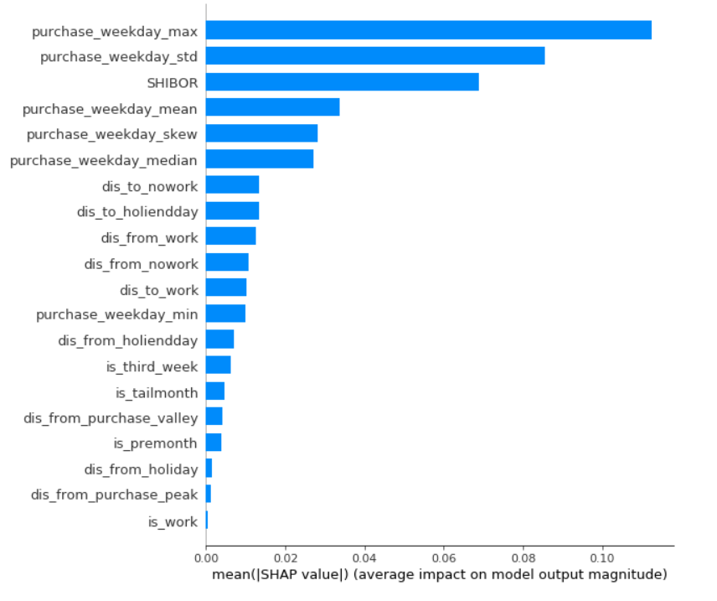
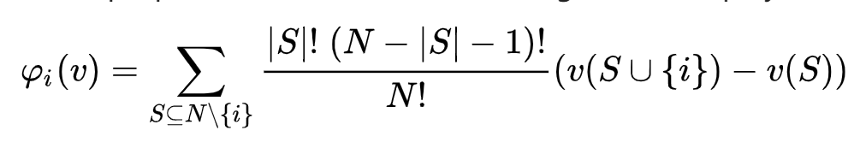
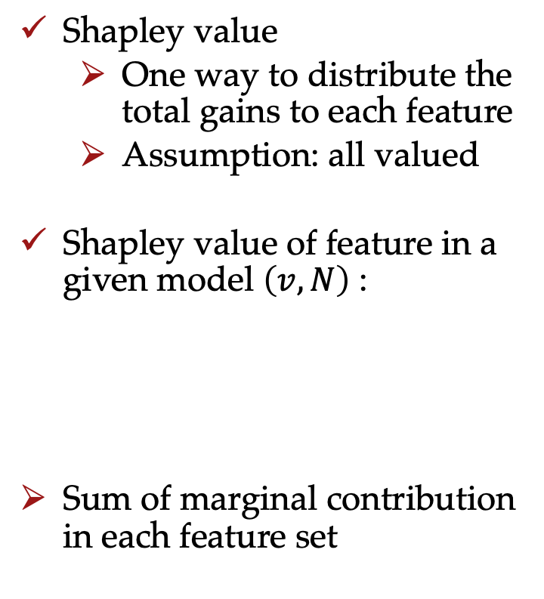
4. Select the features with high Shapley value
Shapley value
One way to distribute the total gains to each feature
Assumption: all valued
Shapley value of feature in a given model $\left(v,N\right)$ :
Sum of marginal contribution in each feature set

Slide 25
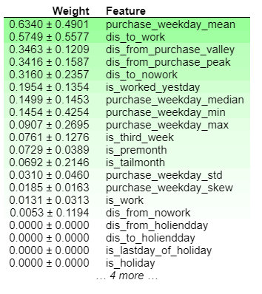
5. Select the features with high permutation importance
Feature values:
Randomly shuffled
One column at a time
Performance of the model is measured before and after
Scores:
Represent the change in the performance of a trained model, after permutation
Important features → usually more sensitive to the shuffling process → higher importance scores

Slide 26
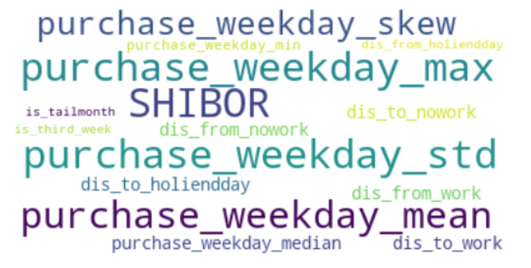
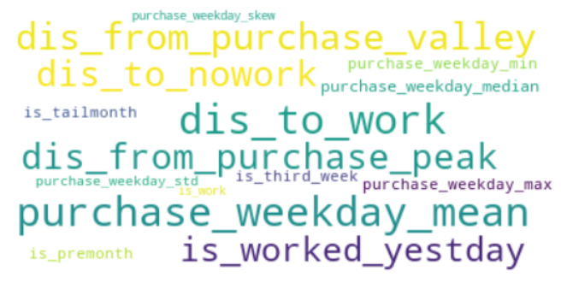
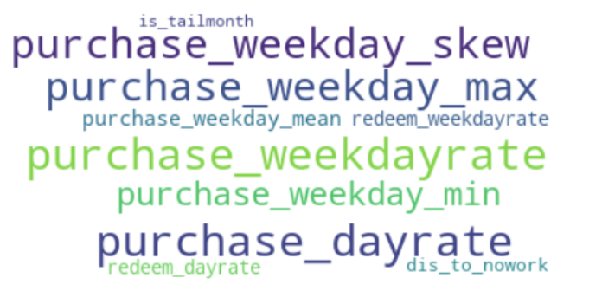
6. Get the intersection of these two selection method
Intersection

Slide 27
03
Model Analysis

Slide 28
3.1 Outline
Purchase features
Linear Regression
Decision Tree Regression
Random Forest Regression
Gradient Boosting Regression
Xgboost Regression
MLP Regression
Prediction and evaluate for test set
Ensemble
Prediction and evaluate for online set
Redeem features

Slide 29
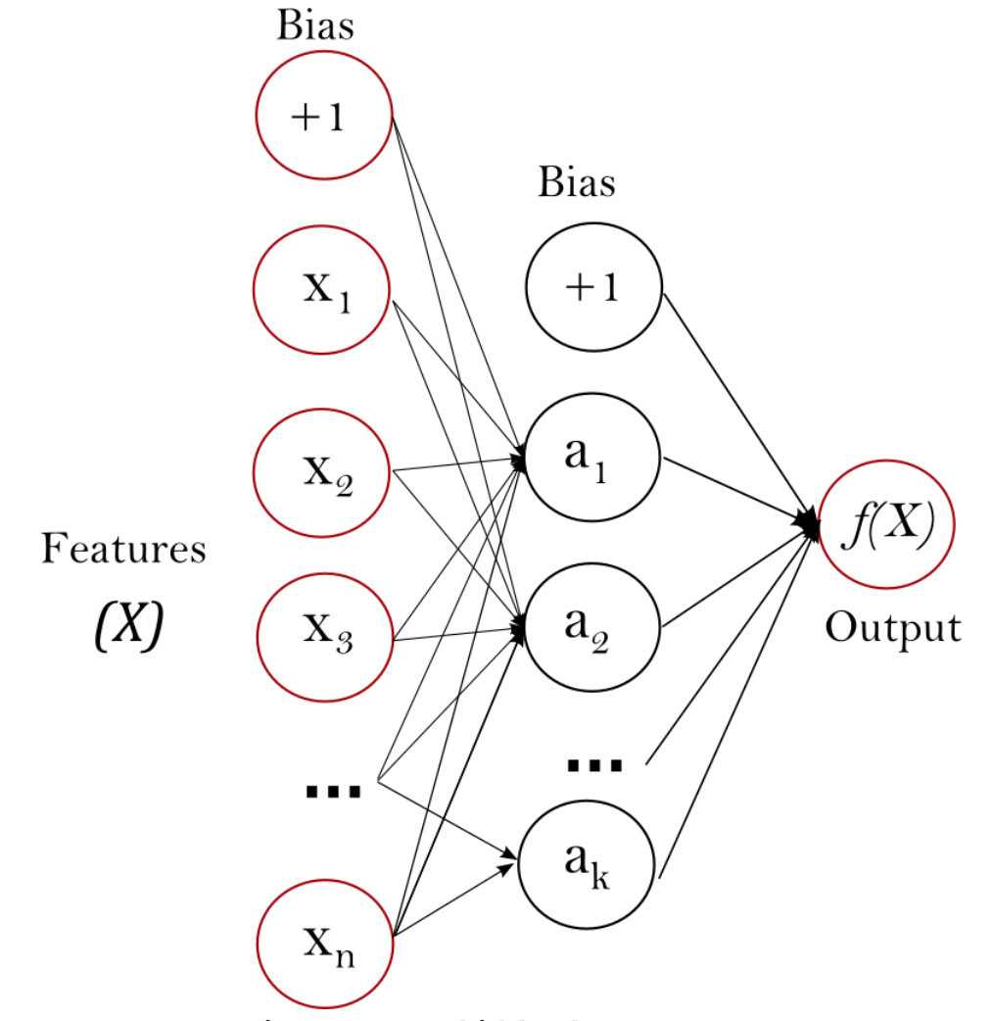
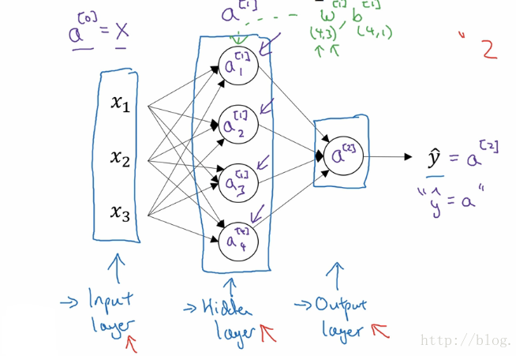
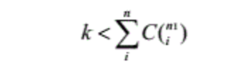
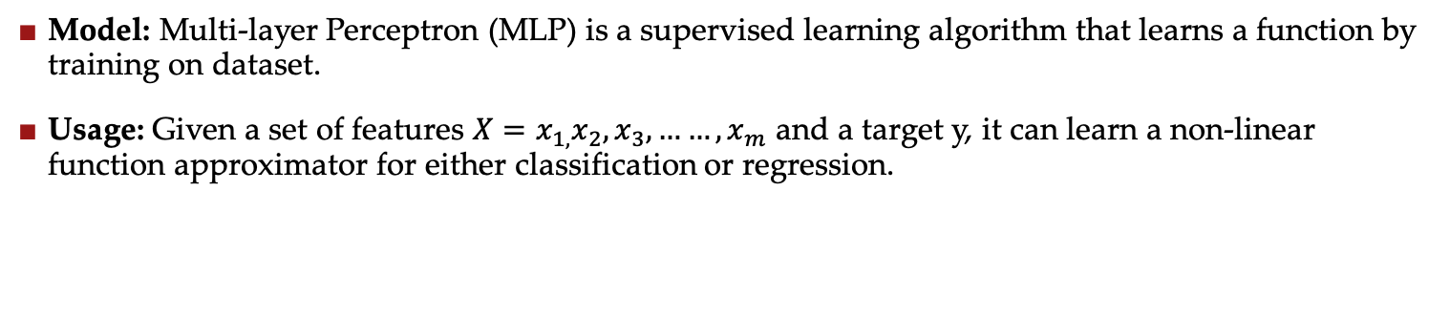
3.2 Multi-layer perception
Model: Multi-layer Perceptron (MLP) is a supervised learning algorithm that learns a function by training on dataset.
Usage: Given a set of features $X=x_{1,}x_{2},x_{3},……,x_{m}$ and a target y, it can learn a non-linear function approximator for either classification or regression.

Slide 30
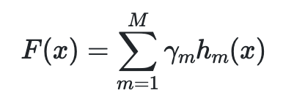
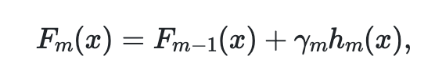
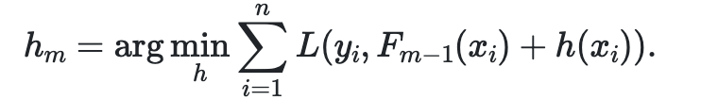
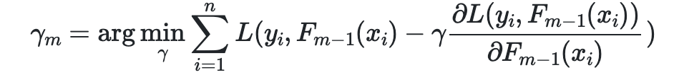
3.3 Gradient Boosted Decision Trees
Model: Gradient Boosted Decision Trees (GBDT) is a generalization of boosting to arbitrary differentiable loss functions.
Usage: Gradient Boosting attempts to solve this minimization problem numerically via steepest descent: The steepest descent direction is the negative gradient of the loss function evaluated at the current model which can be calculated for any differentiable loss function

Slide 31
3.4 Modelling prediction
Multi-Layer Perception
Gradient Boosting Regressor
MLP
Advantages
Capability to learn non-linear models
Capability to learn models in real-time
Disadvantages
Non-convex loss function, different random weight initialization can lead to different validation
Requiring tuning a number of hyperparameters
MLP is sensitive to feature scaling
GBDT
Advantages
Processing different kinds of dataset flexibly, including continuous and discrete values.
Improving accuracy of prediction with the same time used for adjusting parameters.
GBDT is more robust to outliers, which is very useful for this prediction.
Disadvantages
Because of interdependence within weak learners, it is hard for training data in a paralleled way.
Model

Slide 32
3.5 Random Forest
Model: Random Forest is like a boostraping algorithm with decision tree(CART) model.
Usage: Random Forest tries to build multiple CART model with different initial variables
Why we use it in this case?
Easy for us to set parameters, the result doesn’t depend on adjusting parameters.😃
Don’t need to do special treatment for features.😃
Not sensitive to outliers, which is helpful for avoiding overfitting😃

Slide 33
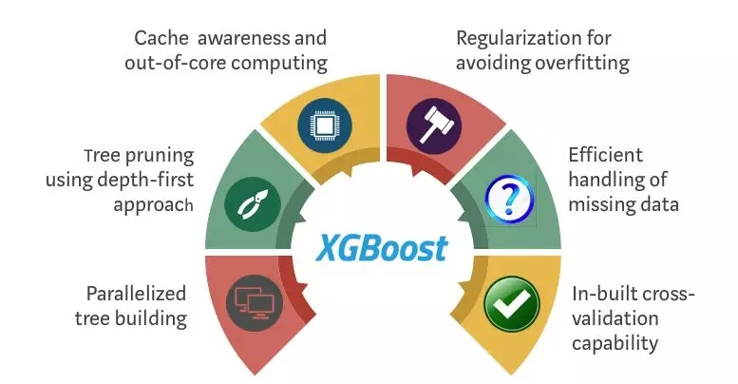
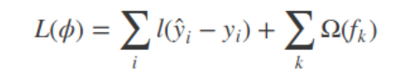
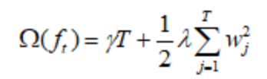
3.5 XGBoost
Model: XGBoost is an optimized distributed gradient boosting library designed to be highly efficient, flexible and portable.
Usage: XGBoost provides a parallel tree boosting (also known as GBDT, GBM) that solve many data science problems in a fast and accurate way. The same code runs on major distributed environment (Hadoop, SGE, MPI) and can solve problems beyond billions of examples.
Notes:
https://xgboost.readthedocs.io/en/latest/

Slide 34
04
Training, Evaluation & Prediction

Slide 35
4.1 Method selection
Single User Modeling
Prediction and summary
Error Accumulation
User Group Modeling
Prediction by group and summary
Daily Amount
Prediction

Slide 36



4.2 Division of training set and test set
August: No holiday, features are useless.
April: Most similar to September.

Slide 37
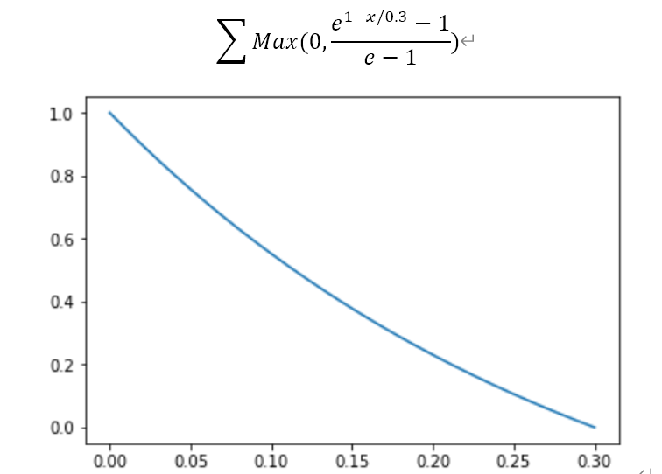
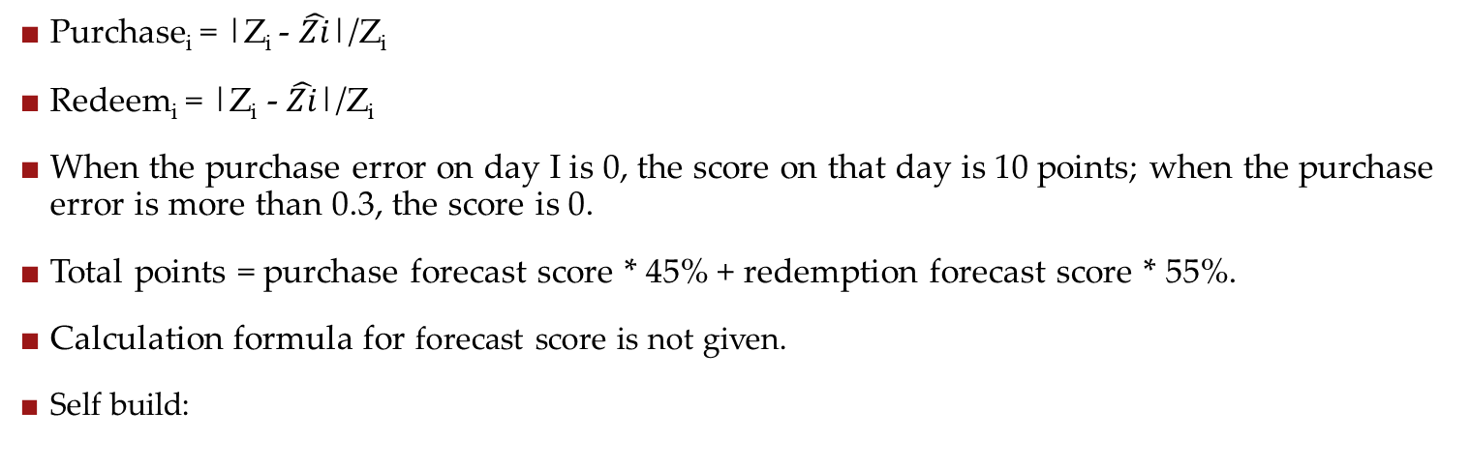
4.3 Self constructed scoring model
Purchase_{i} = |Z_{i} - $\hat{Zi}$|/Z_{i}
Redeem_{i} = |Z_{i} - $\hat{Zi}$|/Z_{i}
When the purchase error on day I is 0, the score on that day is 10 points; when the purchase error is more than 0.3, the score is 0.
Total points = purchase forecast score * 45% + redemption forecast score * 55%.
Calculation formula for forecast score is not given.
Self build:

Slide 38
4.4 Prediction – April as test set
Model | Test Set
Linear Regression | 160.2887
Decision Tree | 179.1604
Random Forest | 192.7704
Gradient Boosting | 202.6532
MLP | 152.5565
XGB | 200.0075
Notes:
Number of Hidden Neurons and number of delays

Slide 39
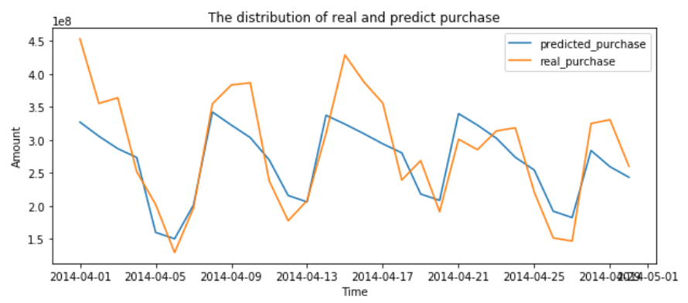
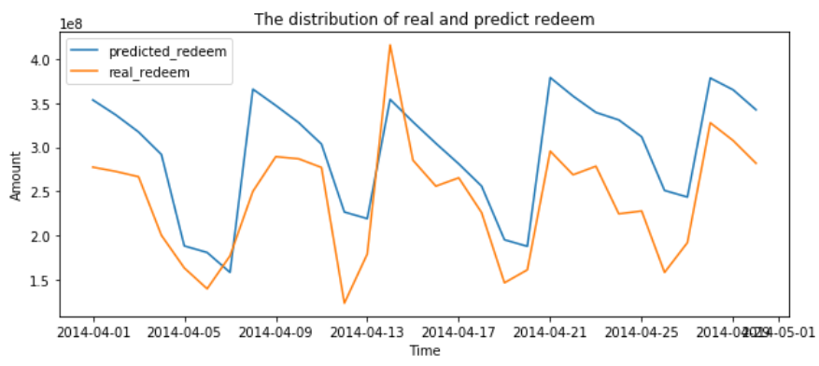
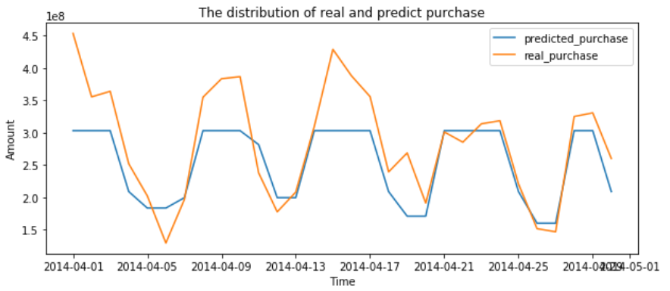
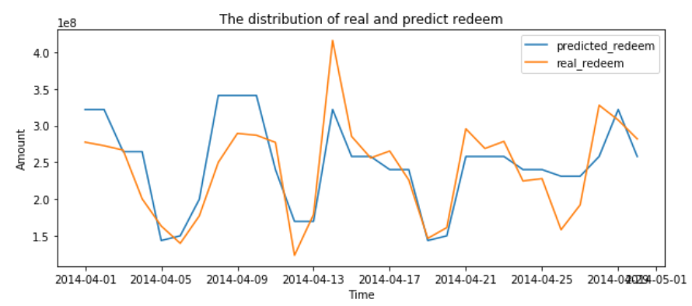
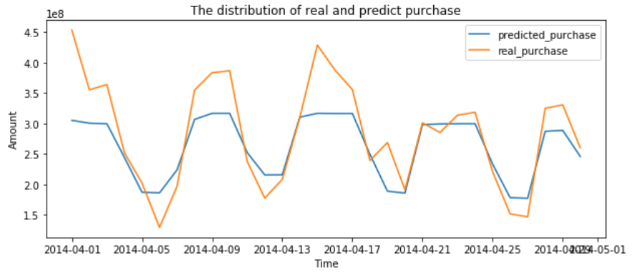
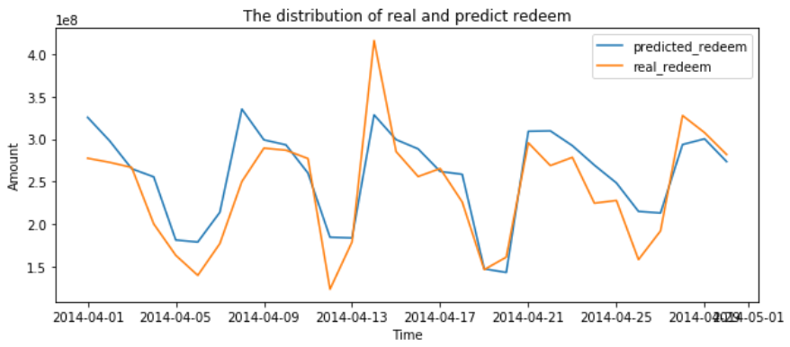
4.5 Prediction – April as test set
Linear Regression
Decision Tree
Random Forest

Slide 40
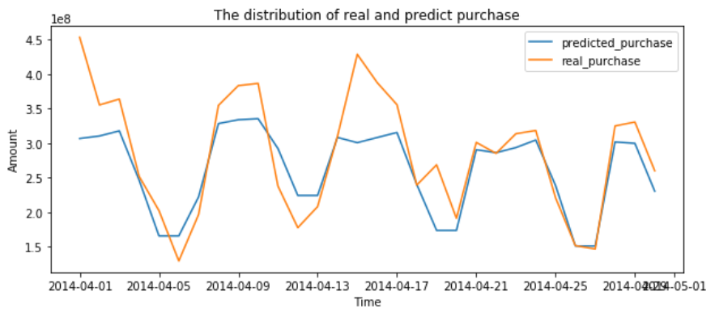
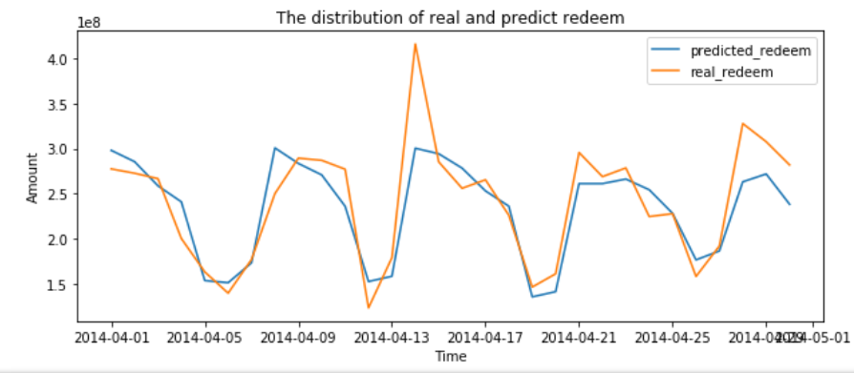
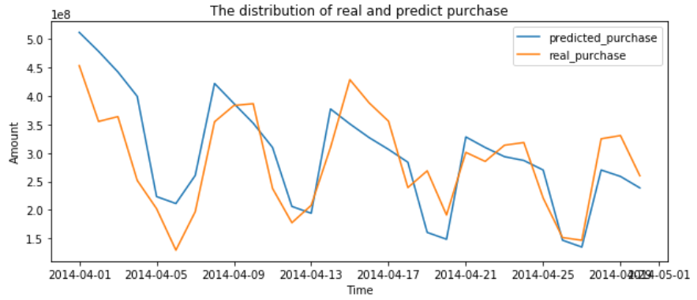
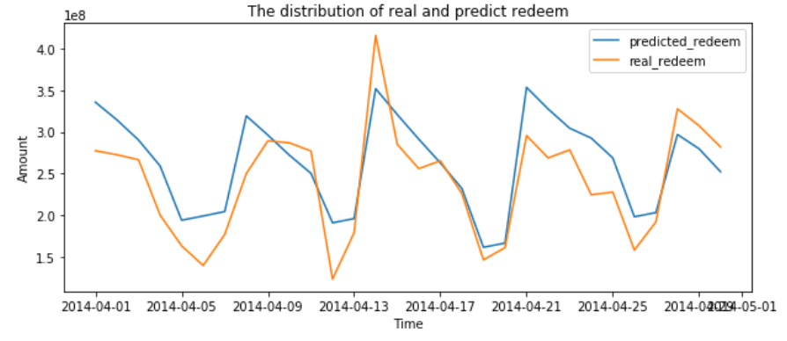

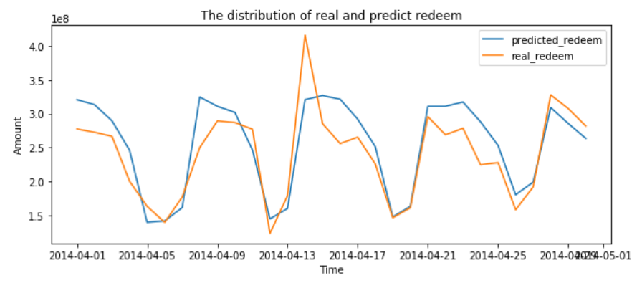
4.6 Prediction – April as test set
Gradient Boosting
MLP
XGB

Slide 41
4.7 Prediction – Online Score
XGB has the best effect, while XGB is not the best in the test set of April.
XGB has stronger generalization ability, and can avoid overfitting problems, as described in our analysis of the model above.
 | Test Set | Online Score
Linear Regression | 160.2887 | 108.7332
Decision Tree | 179.1604 | 87.4493
Random Forest | 192.7704 | 104.8427
Gradient Boosting | 202.6532 | 115.5463
MLP | 152.5565 | 109.3498
XGB | 200.0075 | 119.9311

Slide 42
05
Result Analysis & Interpretation

Slide 43
5.1 Differences between results and expectations
3 differences from our expections:
1
The situation of stock market (expressed by the balance of Margin trading) has little influence on Yu’e Bao;
2
Users of Yu’e Bao are not sensitive to the change of interest rate (expressed by Shibor);
3
"Whether it's a holiday", "whether it's a weekend" and "whether it's a working day" are more significant Features.

Slide 44
5.2 Interpretation 1: Motivation of Yu’e Bao early users
Early users of the Yuebao mainly came from Alipay and Taobao users.
Most of the users mainly used Yuebao as a cash management tool.
Yu’e Bao's early substitutes were not other financial instruments, but mainly bank deposits and cash. Yu’e Bao has higher yield and more convenient access.
Therefore, the purchase and redemption volume of Yu’e Bao in 2014 was less affected by other financial products.

Slide 45
5.3 Interpretation 2: Destination of the redemption
Users can choose to use the amount of Yuebao directly to make payment when they use Alipay payment.
According to the 2014 big data report of Yu’e Bao, 75% of the outflow of Yu’e Bao's funds is used for consumption, and only 25% is used for withdrawal to bank cards.
This explains why features such as "whether it's a holiday", "whether it's a weekend", "whether it's a working day" that have a great impact on consumption also have a great impact on redemption. And why the stock market has little impact on Yu’e Bao in 2014.
Destination of the redemption

Slide 46
5.4 Summary, Prospect and Improvement
Since both the training data and the test data are 2014 data, the conclusion drawn is quite different from the initial guess.
On the one hand, we believe that the influencing factors of Yu’e Bao purchase and redemption data in the future will change greatly with the change of user composition. For the research of the problem, it is worth doing more exploration in the future (if data available).
On the other hand, after finding the data results and expectations are quite different, we actively look for the reasons from three aspects: data, model and fact, and finally find out the reasons successfully. We also feel that data analysis needs to be combined with the actual basic situation, and it is meaningless to do data analysis away from the fundamental information.

Slide 47
References
[1] Belsley, D. A. (1991). Conditioning diagnostics: Collinearity and weak data in regression (No. 519.536 B452). New York: Wiley.
[2] Chatterjee, S., & Price, B. (1977). Selection of variables in a regression equation. Regression Analysis by Example, 201-203.
[3] Scott M Lundberg and Su-In Lee. 2017. A Unified Approach to Interpret- ing Model Predictions. In Advances in Neural Information Processing Sys- tems 30. Curran Associates, Inc., 4768–4777. http://papers.nips.cc/paper/ 7062- a- unified- approach- to- interpreting- model- predictions.pdf
[4] Scott M Lundberg, Bala Nair, Monica S Vavilala, Mayumi Horibe, Michael J Eisses, Trevor Adams, David E Liston, Daniel King-Wai Low, Shu-Fang New- man, Jerry Kim, et al. 2017. Explainable machine learning predictions to help anesthesiologists prevent hypoxemia during surgery. bioRxiv (2017), 206540.
[5] Lundberg, S. M., Erion, G. G., & Lee, S. I. (2018). Consistent individualized feature attribution for tree ensembles. arXiv preprint arXiv:1802.03888.
[6] Lundberg, S. M., & Lee, S. I. (2017). A unified approach to interpreting model predictions. In Advances in Neural Information Processing Systems (pp. 4765-4774).
[7] Altmann, A., Toloşi, L., Sander, O., & Lengauer, T. (2010). Permutation importance: a corrected feature importance measure. Bioinformatics, 26(10), 1340-1347.

Slide 48
References
[8] Achard,S. et al. (2005) Criteria based on mutual information minimization for blind source separation in post nonlinear mixtures. Signal Processing, 85, 965–974.
[9] Strobl,C. et al. (2007) Bias in random forest variable importance measures: Illustrations, sources and a solution. BMC Bioinformatics, 8, 25.
[10] Guyon,I. and Elisseeff,A. (2003) An introduction to variable and feature selection. J. Mach. Learn. Res., 3, 1157–1182.
[11] Breiman,L. et al. (1984) Classification and regression trees. Wadsworth & Brooks/Cole Advanced Books & Software, Monterey, CA.
[12] Breiman,L. (2001) Random Forests. Mach. Learn., 45, 5–32.
[13] Guyon,I. and Elisseeff,A. (2003) An introduction to variable and feature selection. J. Mach. Learn. Res., 3, 1157–1182.
[14] Chen, T., & Guestrin, C. (2016, August). Xgboost: A scalable tree boosting system. In Proceedings of the 22nd acm sigkdd international conference on knowledge discovery and data mining (pp. 785-794). ACM.
[15] Chen, T., He, T., Benesty, M., Khotilovich, V., & Tang, Y. (2015). Xgboost: extreme gradient boosting. R package version 0.4-2, 1-4.

Slide 49
References
[16] Quinlan, J. R. (1987). Simplifying decision trees. International journal of man-machine studies, 27(3), 221-234.
[17] Longstaff, I. D., & Cross, J. F. (1987). A pattern recognition approach to understanding the multi-layer perception. Pattern Recognition Letters, 5(5), 315-319.
[18] Prettenhofer, P., & Louppe, G. (2014). Gradient boosted regression trees in scikit-learn.
[19] Ruck, D. W., Rogers, S. K., Kabrisky, M., Oxley, M. E., & Suter, B. W. (1990). The multilayer perceptron as an approximation to a Bayes optimal discriminant function. IEEE Transactions on Neural Networks, 1(4), 296-298.
[20] Pal, S. K., & Mitra, S. (1992). Multilayer perceptron, fuzzy sets, and classification. IEEE Transactions on neural networks, 3(5), 683-697.
[21] Liaw, A., & Wiener, M. (2002). Classification and regression by randomForest. R news, 2(3), 18-22.

Slide 50
Q&A
Enjoy our final!

